Slide 1
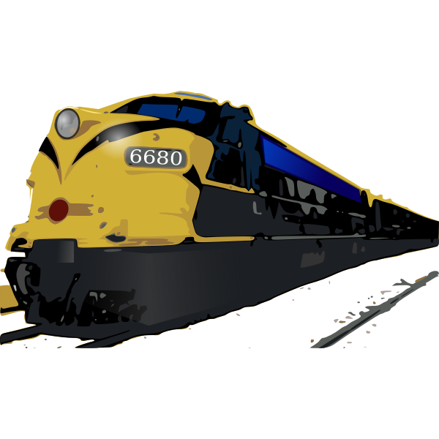
Automated Railway Crossing System
Group 21
Bandara H.M.J.S.P
Abeykoon A.M.P.N.G
Rajith D. L. L. V.
Kalansuriya G.C.

Slide 2

Introduction
This is a newly concept designed for the railway crossing system in Sri Lanka. As most of the railway gates used in Sri Lanka are driven manually by the help of human, we came up with an idea to do the same task with the help of technology for automating the railway gates in Sri Lanka.

Slide 3
Problem
Every railway crossing are controlled by the humans.
Today the Railway department cannot find the workers to control the crossings.
Annually Most of the accidents occur in these railway crossings.
Therefore many human lives are lost annually due to this reason
There is a danger in running this railway crossing by humans.
So we came up with this idea!

Slide 4

Solution
This doesn’t need any manpower to control(Automated).
That will be a great relief to the railway department.
The number of accidents will be reduced to the new system.
So many human lives will be saved.
Also, this will be an efficient way that saves the time of citizens

Slide 5
Automated Railway Crossing Management System
(ARCMS)

Slide 6
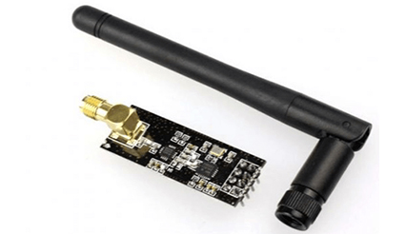
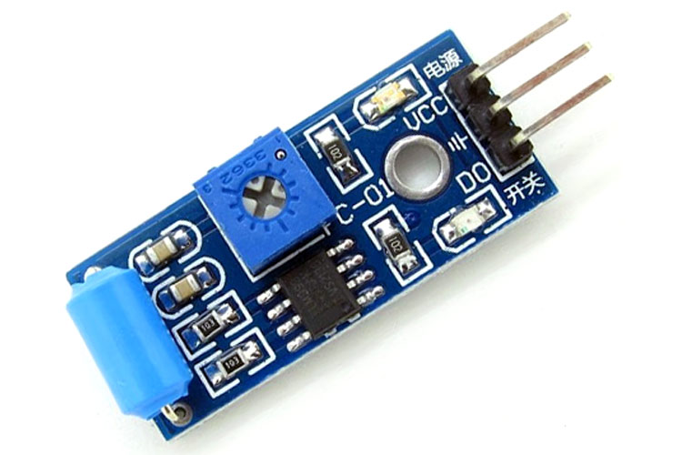
Product
In automatic gate system we have to determine when the train arrives near the gate. We mounted a sensing part 1km far from the gate near the railway. Then we can detect when the train arrives to the railway gate .Sensing box can determine when the train is passing through the place from where the box is mounted. In the sensing box included two sensors. Generally, we use vibration sensor to detect the train’s vibration. But sometimes there may be vibrations in earthquakes also. Therefore, we use rf transmitter and receiver . when the train is passing through the location where the sensor is mounted, rf transmitter emits a signal to the sensing box which mounted on the train. When the vibrations and rf signal from the train is detected by the sensing box, it will emit a rf signal to gate receiver. Then gate receiver determined that train is reaching to the gate. After that gate closing procedure will take place. We use another vibration sensor to open the gate. When the sensor does not detect the vibration, the gate will be opened.
2.4G Long Distance NRF24L01+PA+LNA Wireless Transceiver Modules With Antenna
Vibration SW-420 Sensor

Slide 7

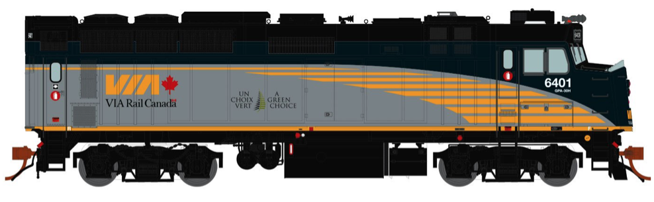
Display system
RF Receiver (from train) & RF transmitter
(to gate)
Train Signal Transmitter
Receiver
Vibration sensor
Vibration sensor
Train Approaching Detecting System
Train leaving Detecting System

Slide 8




Slide 9
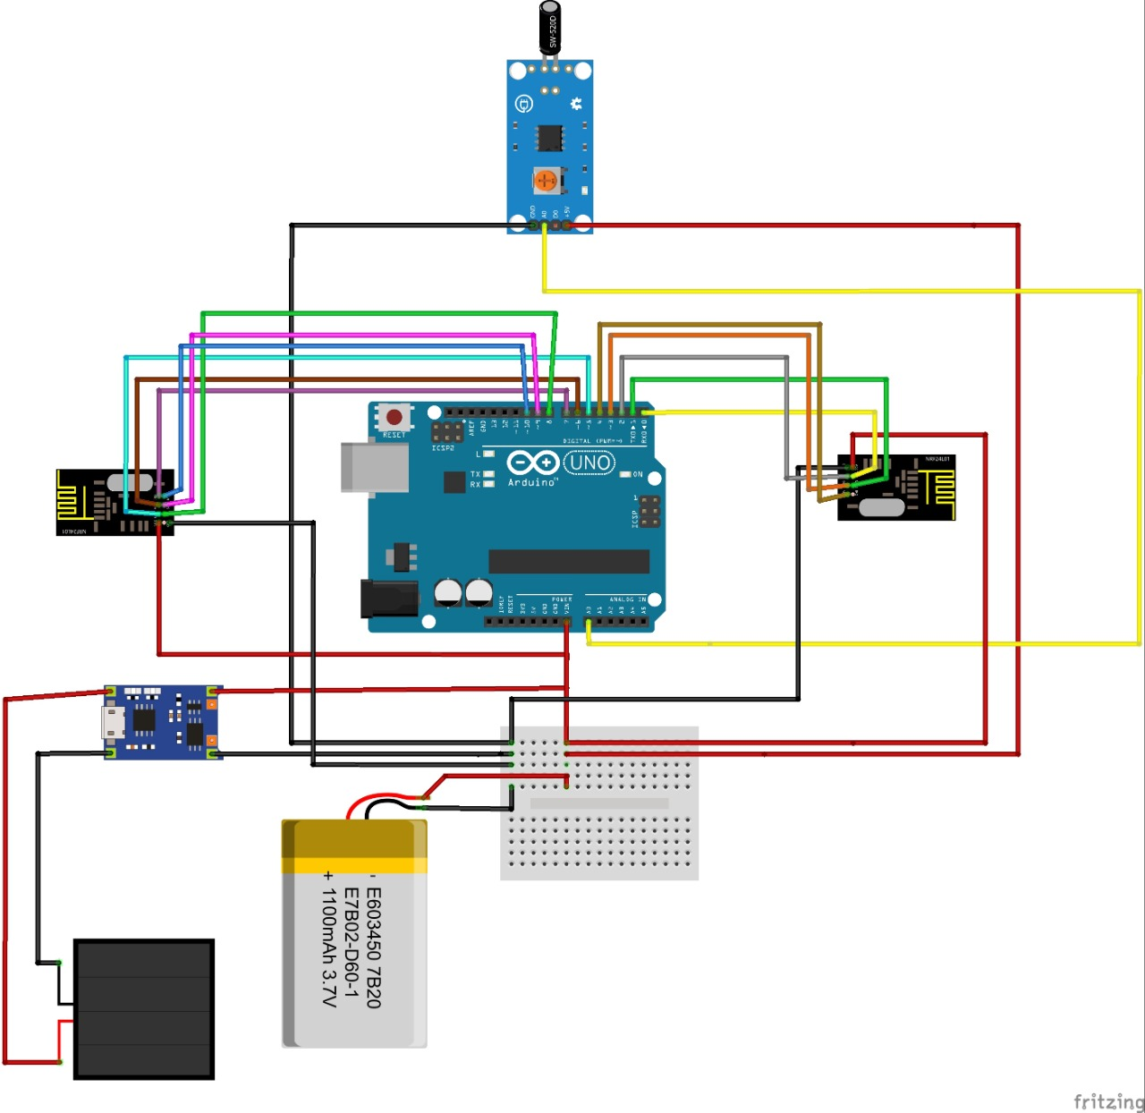
Train Approaching Detector
Vibration sensor
(SW18010P)
RF receiver
(NRF24L01+PA+LNA)
RF transmitter
(NRF24L01+PA+LNA)
Atmega 328P
Boost converter
(to 5V)
12V(6Vx2) Solar panels
Li-ion 5v Battery

Slide 10
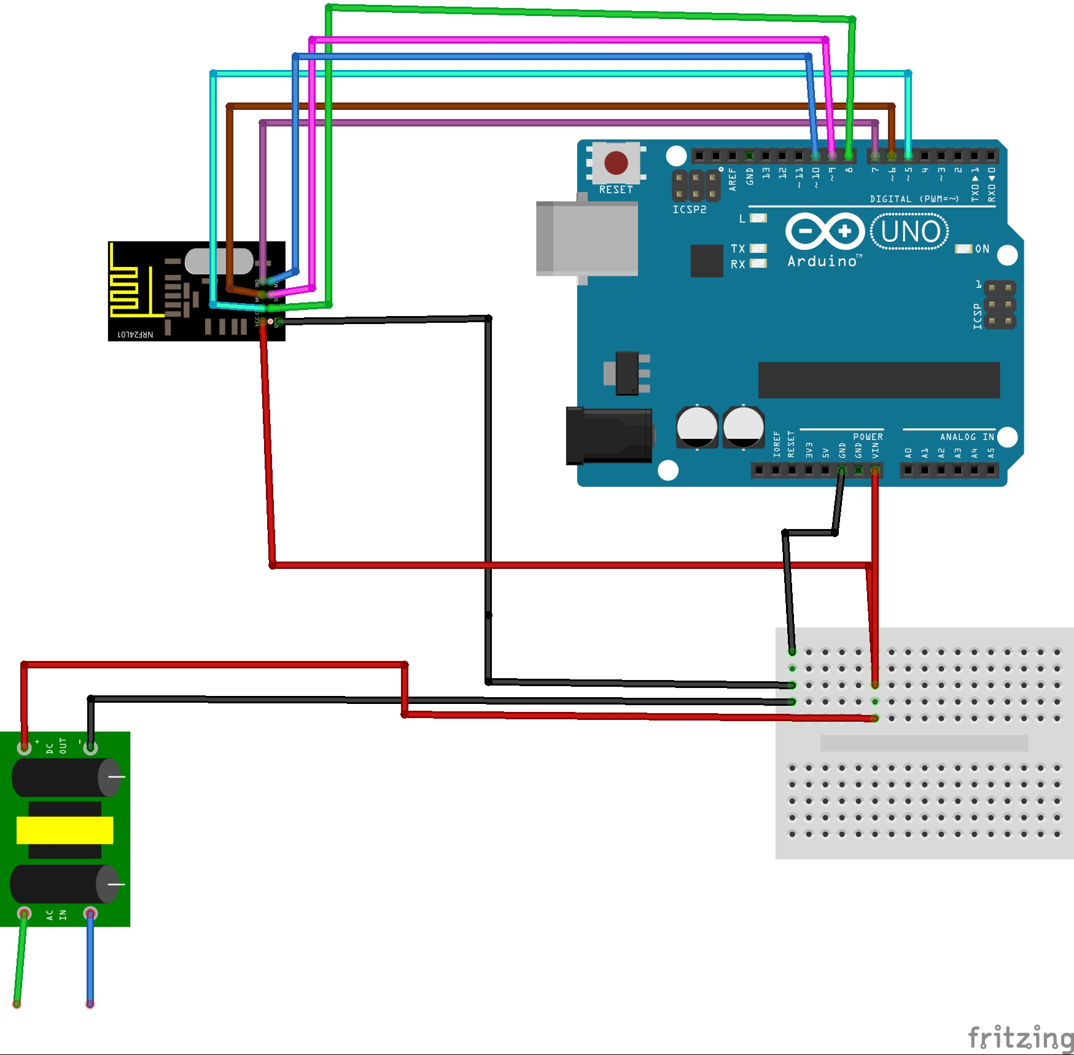

Train Signal Transmitter
RF transmitter
(NRF24L01+PA+LNA)
Atmega 328P
AC to DC convertor
AC supply

Slide 11
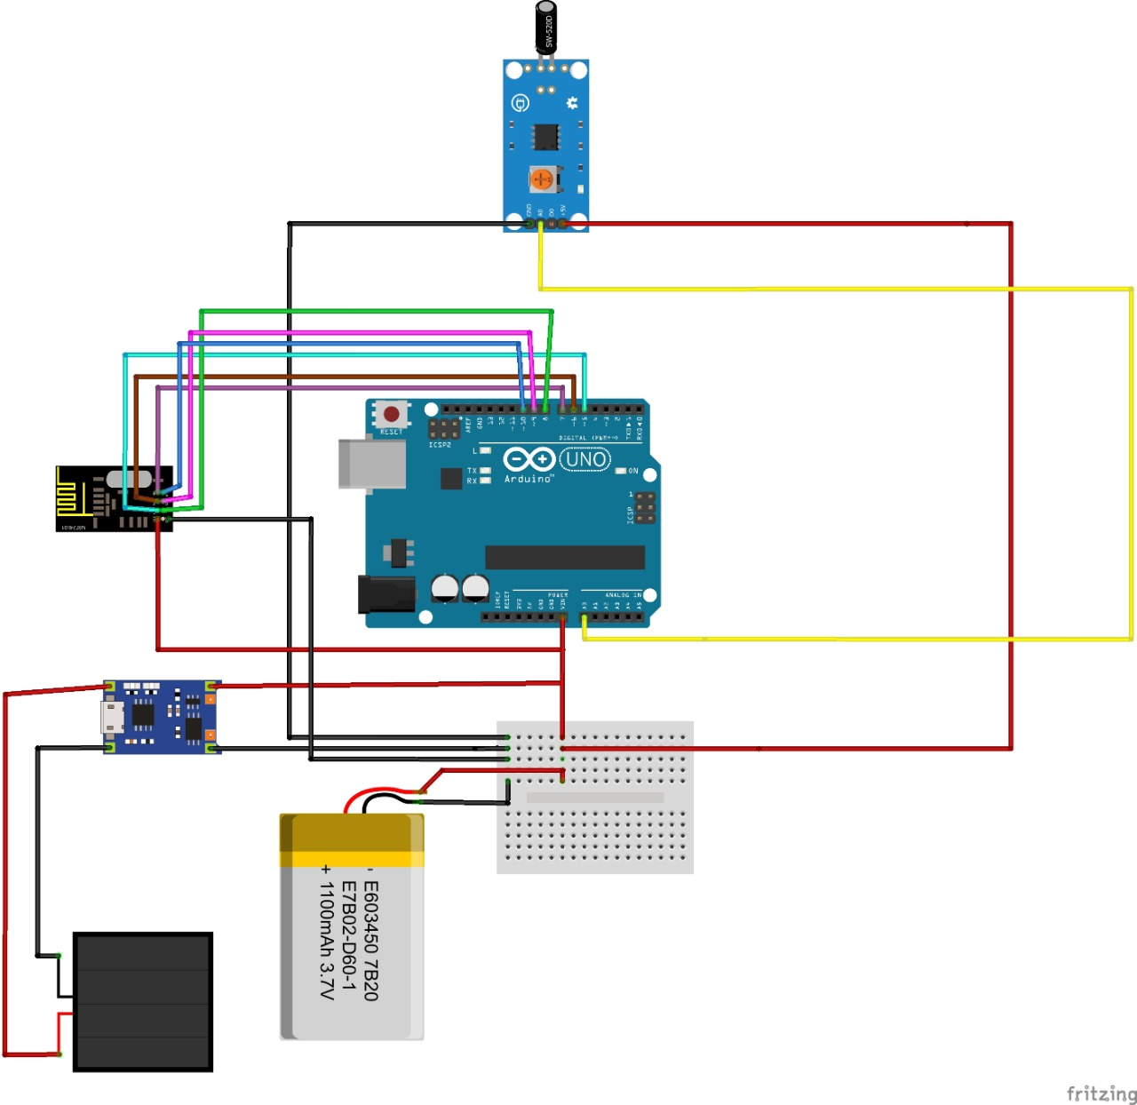
Train Leaving Detector
Vibration sensor
(SW18010P)
RF transmitter
(NRF24L01+PA+LNA)
Atmega 328P
Boost converter
(to 5V)
12V(6Vx2) Solar panels
Li-ion 5v Battery

Slide 12
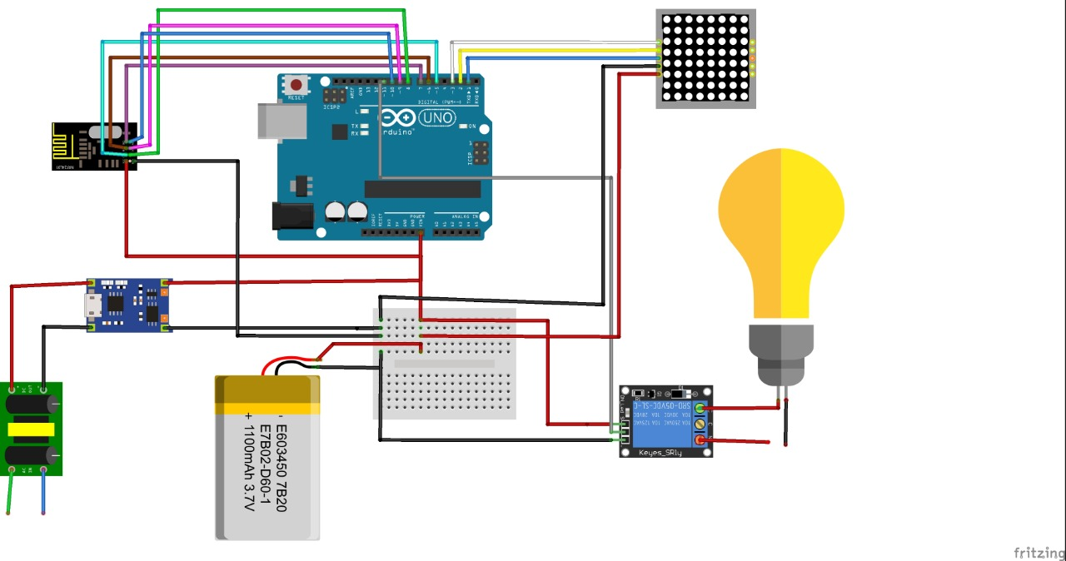

Display System
LED display
RF receiver
(NRF24L01+PA+LNA)
Atmega 328P
Boost converter
(to 5V)
AC to DC convertor
AC supply
Li-ion 5v Battery

Slide 13
SW-18015P Vibration Sensor
Max voltage: 12V
Max current: 50mA
Closed resistance <10 ohm
Open resistance: >10M ohm
Operating temperature range: -40 to 80 C
Operating lifespan: up to 200,000 cycles
Dimensions (excluding pin): 4.77mm (0.19in) diameter x 11.18mm (0.44in) length
Dimensions (including pin): 21.5mm (0.85") length
Weight: 0.22g (.008oz)

Slide 14
NRF24L01+PA+LNA
Operating Frequency: 2400MHz ~ 2524MHz
Transmit power: more than +20 dbm, 50Ω
Receiver sensitivity:-95dbm
Operating voltage: 2.7V ~ 3.6V
Max Emission current: 115mA
Max Receive current: 45mA
Operating temperature: -45 degrees to +85 degrees
Storage temperature: -45 degrees to +125 degrees

Slide 15
THANK YOU

